Slide 1
nwseo 41 years strong – powered by membership
Communications & Recruitment
Lisa Luciani NWSEO Executive Director
Notes:
Thank members for attending convention. WWE ARE MOST EFFECTIVE WHEN WE WORK TOGETHER. Yesterday’s presentations by various team members is a perfect example.
As members – you are the engine that drives NWSEO – we say it again and again – NWSEO is not the President - or leadership – it’s you. So thank you for being here. I hope you are enjoying the weekend.

Slide 2
NWSEO Media Results
Circulation, Viewers, Digital Impressions
Print – 1 million
Television 8. 27 million
Online – more than 100 million
Notes:
We’ve been able to build good relationships with journalists. I’d like to continue the momentum. $3-5K media lists/distribution services, News feed PR Newswire, Best results are our homegrown. In the upload – you have a media list. We’ve done well – because your NWS and everyone is intereste. Think how much better we could do if everyone completed this list. If you could add local media and email it to me -

Slide 3
NWSEO Communications
Focused – message
Targeted- audience
Strategic - delivery
Strong Relationships
Members of Congress
Emergency Managers
Journalists
Notes:
What is our strategic goal? Impact we want to make? Target audience? /decision makers in Congress/NWS
Before we send a Four Winds or post something on the website = we discuss who is going to see it. Informing our members is always our top priority – but we also work with the constraints that publishing information could jeopardize negotiations. The website is public – We are very aware that members of Congress and NWS management reads it.
FB – while the page is supposed to be private, we are aware that management has seen posts that were copied and emailed to them. So, even when we post on FB – we have that in mind.
Journalists - we are on a first nae basis with many journalists from national publications.

Slide 4
“I am deeply troubled by the NWS’s recent short-sighted actions regarding aviation meteorologists,” stated Congressman Dan Lipinski (IL-3). “As the most senior member from Illinois on the Transportation & Infrastructure Committee, and a member of the Aviation subcommittee, my top priority has been and always will be the public’s safety. It has been proven that these employees are essential personnel, improving safety and overall efficiency.”
Notes:
WORK WITH GINO IZZI STEWARD AT ROMEOVILLE/CHICAGO WFO – GOLDEN TRIANGLE – HIRN’S WORK WITH CONGRESSMAN DAN LIPINSKI- IL

Slide 5
One United Message
The impact of all members working to:
Bang the drum – we can do this from coast to coast and beyond. (National Media Lists needed)
Resonate in one voice – Our media campaigns and news releases are strategic in nature.
Stay on message – if you have questions contact us OR defer to leadership. We will work with you to make sure your message to the media reflects your local office.
Notes:
We are NWSEO – Active support is crucial to successful media relations.
We have the unique advantage of having stewards in all parts of the country. When we speak with one voice – we can achieve great things.

Slide 6
The Making of a National News Story
National media lists
Strong Pitch with key messages
Members for interviews
Personal stories/accounts
Emergency personnel
Notes:
When we have our next media campaign, remember…

Slide 7
In the news business…
Timing is Everything
Notes:
One of my first questions when talking with a journalist– when do you need this by?

Slide 8
December 28, 2015 NBC 5 Investigates
Texas Tornado
News story: http://www.nbcdfw.com/investigations/NBC5-Investigates-Staff-Shortage-Left-NWS-Scrambling-To-Cover-Tornado-Outbreak-363607261.html
Key messages:
Continued high vacancies
Dedication of NWS employees
Forecast reliability
Importance of fully staffed offices
Notes:
THIS STEWARD IS JASON DUNN and BILL PROENZA. TALK ABOUT JOE MALONEY AND PB POST TOO.

Slide 9
INITIATIVES, ISSUES, AND NEWS STORIES
October 9, 2015– Philadelphia Inquirer: Weather Service Union Blasts "Gag Orders"
October 9, 2015 - Government Executive: Weather Service Staffers Protest "Gag Orders" on Workforce Planning
December 28, Dallas/Fort Worth-NBC5 Investigates: Staff Shortage Left NWS Scrambling To Cover Tornado Outbreak
January 24, Palm Beach Post - Weather Service vacancies concern during severe weather year
February 12, Chicago Tribune - Meteorologists union warns of more flight delays in Chicago because of cutbacks
February 9, Federal Soup - Union: Just a few job cuts will harm Chicago air traffic
February 21, The Weather Channel – Weather Geeks host Marshall Shepherd discuss the NWS workforce with NWSEO President Dan Sobien
July 13, 2016 - Washington Post - Weather Service suffers "major network issue," warning system compromised.
July 14, 2016 NBC 5 Dallas - Computer Outage Disrupts National Weather Service Offices Nationwide

Slide 10
Congresswoman Gwen Graham visits TAE Holds private meeting with NWSEO
Notes:
FEB VISIT TO TAE – VACANCIES – GAO REPORT – DOUG MCDONNEL – SENT THEM TO MIAMI, PHILLY, ELDO, TALLAHASSEE –HIGHLIGHT HURRICANE SEASON (WORK WITH MIC AND MARK WOOL)
MET WITH GRAHAM IN HER OFFICE – GAO – KELLY’S STORY

Slide 11
We are in this together.
We are most effective when we work together.
Notes:
I am hear to help you. If we ask you to send the news release to your local TV wx forecasters and you want to talk with me first… I’m just an email or phone call away.
A lot of times, the media will call me first and ask me to find someone at the WFO – I will usually talk with them to get an idea of the questions they are going to ask – to help you prepare. Pre-Interview. Also, I may feed them information that will assist the story.

Slide 12
1044 members
564 followers
854 members
Protect the National Weather Service page
157,213 Likes

Slide 13
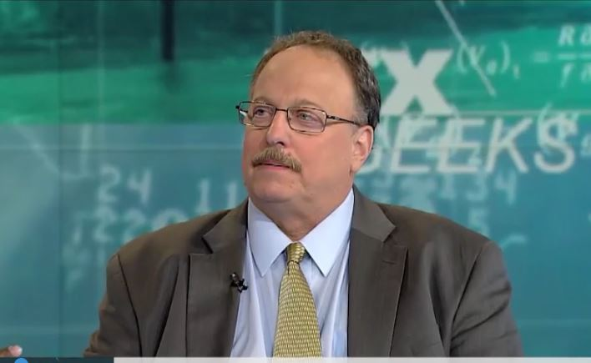
The Weather Channel’s Marshall Shepherd interviews
NWSEO President Dan Sobien on the Weather Geeks Show.

Slide 14
Retirement Eligibility
RECRUITMENT
We are most effective
when we work together

Slide 15
This is a website for NWSEO members only. Discounts can be up to 70 percent off the current hotel rates. Please see your office steward for the password.
Thank you for your NWSEO membership.

Slide 16
Recruitment
Most effective form of recruitment – Members recruiting co-workers.
NWSEO.org Recruitment Page
Recruitment Folder includes tips, suggestions and NWSEOs list of achievements.
Annual Recruitment Incentive
Notes:
RECOGNIZE TOP RECRUITERS

Slide 17
No one cares more for NWS employees than NWS employees.
No one works harder for NWS employees than NWS employees. We are NWSEO.

