Slide 1
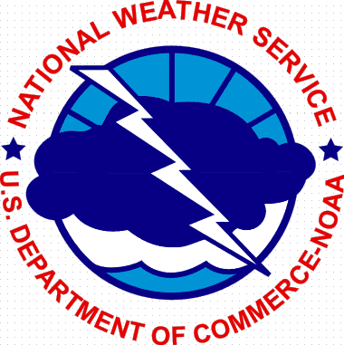
The Importance of the
U.S. National Weather Service brand and a bit of our agency’s history !
NWSEO Annual Meeting
Salt Lake City, Utah – September 26, 2016
Bill Proenza, Retired Regional Director
United States National Weather Service
Notes:
An outside the DC Beltway view

Slide 2
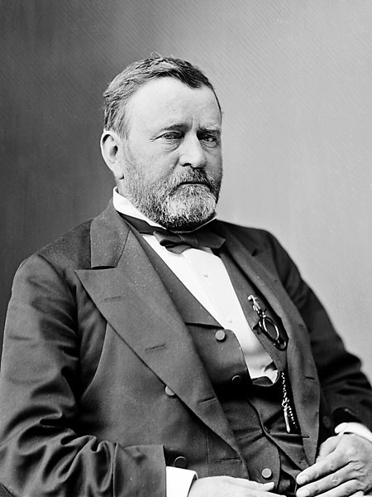
President Ulysses S Grant officially established our National Weather Service under the US Signal Service Corp on February 9, 1870, when he signed a Congressional resolution.
The mission stated: "to provide for taking meteorological observations at the military stations in the interior of the continent and at other points in the States and Territories...and for giving notice on the northern (Great) Lakes and on the seacoast by magnetic telegraph and marine signals, of the approach and force of storms“

Slide 3
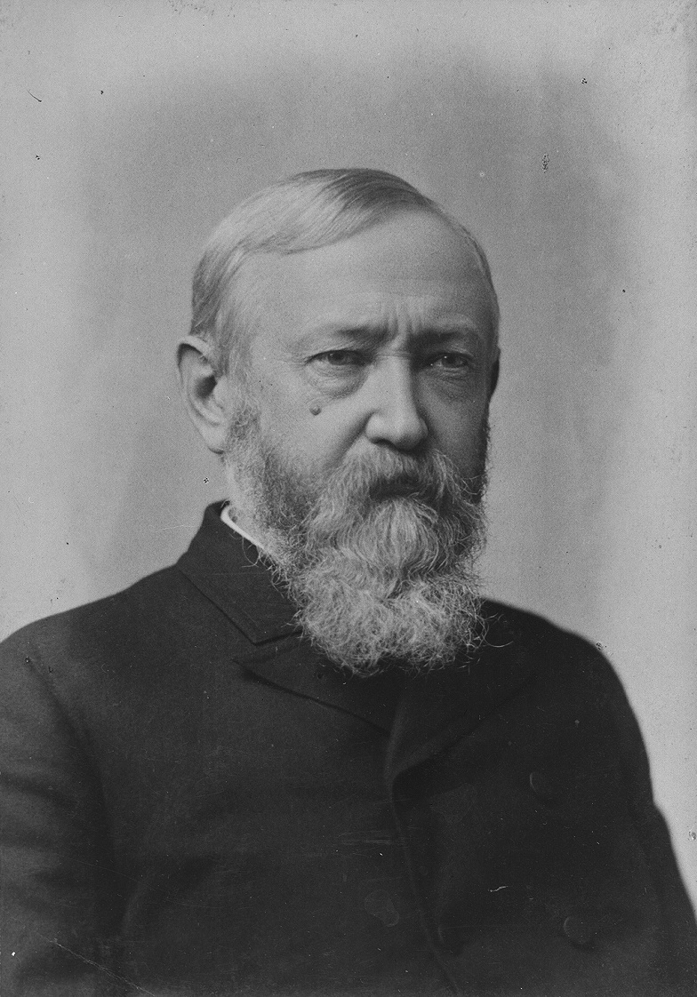
On October 1, 1890: At the request of President Harrison, the U.S. National Weather Service is first identified as a civilian agency when Congress passes an act transferring the meteorological responsibilities of the Signal Service to the newly-created U.S. Weather Bureau in the Department of Agriculture.
Therefore in 1891, the nation’s weather stations, telegraph lines, apparatus, and personnel (were honorably discharged to civilian status) were transferred to the DoA for the benefit of commerce and agriculture.

Slide 4
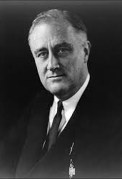
By executive order in 1940, President Franklin D. Roosevelt transferred the U.S. Weather Bureau to the Department of Commerce.
Note: At this time there was a growing awareness and dependence on the U.S. Weather Bureau for its very significant protection of life mission with forecasts and warnings, expanded weather support to aviation and documentation of the nation’s climate. All of these activities demonstrating a vital contribution to the nation’s wellbeing. bp

Slide 5
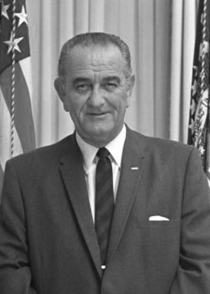
In President Johnson’s Reorganization of 1965, the Environmental Science Services Administration (ESSA) was established consolidating the Coast and Geodetic Survey and the U.S. Weather Bureau. The President wanted, a single national focus…to describe, understand, and predict (with adequate warnings as necessary) the state of the oceans, the state of the lower and upper atmosphere, and the size and shape of the Earth.

Slide 6
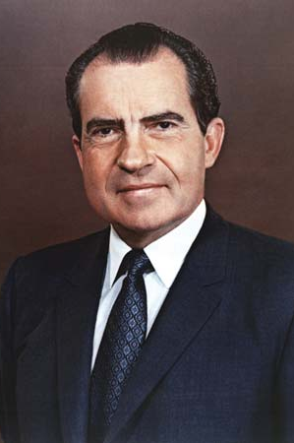
By virtue of Executive Order 11564, President Nixon transferred certain functions to the Secretary of Commerce and established the National Oceanic and Atmospheric Administration (NOAA) in the Department of Commerce on October 7, 1970.

Slide 7
Partial list of lost NWS positions since NOAA’s enactment
1971-1972: US NWS State Climatologist program eliminated and 45 NWS FTEs moved to NOAA HQs. A move Robert M. White told me he has regretted.
1982-1983: 150+ US NWS personnel support specialists, admin/property/budget staff, and facility techs transferred to NOAA HQs and four Administrative Support Centers to support NWS and other NOAA field components.
1997: SRH closure successfully averted but NWS ROs still lose 80 positions (NOAA keeps about half).

Slide 8
Partial list of lost NWS positions since NOAA’s enactment…cont.
2006-present: NOAA decimates the above ASC field staffs leading to lapses in vital NWS support!
2011: NOAA greatly slows down NWS recruiting…last two years NWS has suffered an average of 600+ vacancies!
Now the US NWS field has experienced downsizing & part-timing in Alaska.
DC area headquarters continues talking about integration, consolidation and modeling as a way to facilitate field staffing cutbacks to our 24x7 mission delivery offices across the remaining 49 states!

Slide 9
From: NOAA Weather Client Service Division in KC (name redacted)
Sent: Monday, October 17, 2011 3:07 PM
To: All NOAA recruiting personnel officers (names redacted)
Subject: DO NOT POST ANY JOAs
Please do not post any JOAs at this time. Sam has been working with the
LO/SO in developing Strategic Workforce Plans from the LO/SOs to share
hiring needs for FY 2012. Reality is that NOAA's budget has been cut and we
need to require our customers to plan and set priorities to avoid the worse
scenario.
We do not want to hire any positions that are not listed in the Workforce
Plans. This is a new way of doing business for NOAA.... Each vacancy will go
through a Budget, LO/SO and WFMO clearance before it is advertised.
More information will come.
___________________________________________________________________
NOTE, In the above email: WFMO means NOAA’s WorkForce Management Office i.e. the personnel office. JOAs means the official "Job Opportunity Announcements" (JOAs) that start the recruitment process for any vacancy. When this email relays the order ("...do not post any JOAs...") and refers to "Sam", nickname of NOAA’s Acting Director of all Personnel services.

Slide 10
U.S. National Weather Service Brand
In our representative type of government, gaining attribution for our services is vital to the success of our annual appropriations.
After all, if the public and our media & EM stakeholders are pleased with our services and recognize it comes from the US NWS, the Congress will more likely fund what their constituency supports.
This is why NOAA interjects themselves as the source or owner of US NWS products and services. Commerce normally doesn’t do this with NOAA.

Slide 11
NOAA imposes ownership frequently by stating such things as “NOAA’s forecasts”, “NOAA’s seasonal Hurricane Outlook”, “NOAA’s tsunami statement”, even “NOAA’s forecasters”, “NOAA’s Weather Service” or “Storm Prediction Center”!
In other words, they confuse the attribution process and take the credit on their press releases.
They do that to the Ocean Service, to Fisheries, to OAR…it certainly isn’t only NWS.
But the fact is, no government agency belongs to another even within its organization! Bottom line, the U.S. National Weather Service belongs to the People! This is really a PR “faux pas!”

Slide 12
When NOAA was founded in 1970, within months they changed the name of Weather Radio to NOAA Weather Radio.
NOAA Hqs has been resisting the use of the US NWS emblem since the 80s by arguing a “third level agency” is not allowed their own emblem. But the Navy doesn’t tell the US Marine Corps’ that their “third level agency” emblem is unacceptable!
After a follow up national press interview of Bob Ricks over his timely & urgent Hurricane Katrina warning from WFO Slidell, NOAA actually called the region to complain that Ricks must show the NOAA emblem instead of the NWS in his interviews!

Slide 13
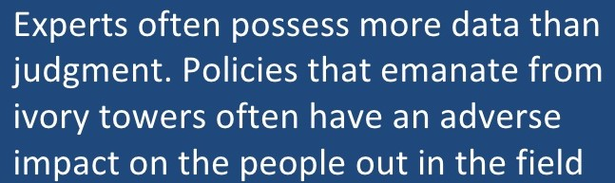
Does the quoted statement above from Colin Powell’s “lesson’s for leaders” sound somewhat relevant about the US NWS reorganization proposals and or “predecisional” conversations the field continues to hear from headquarters?
Powell’s point is, it’s up to the mission delivery field offices to carefully vet operational policies emanating from DC area “experts”. This requires a lot of persistent factual and respectful communications from field offices. bp

Slide 14
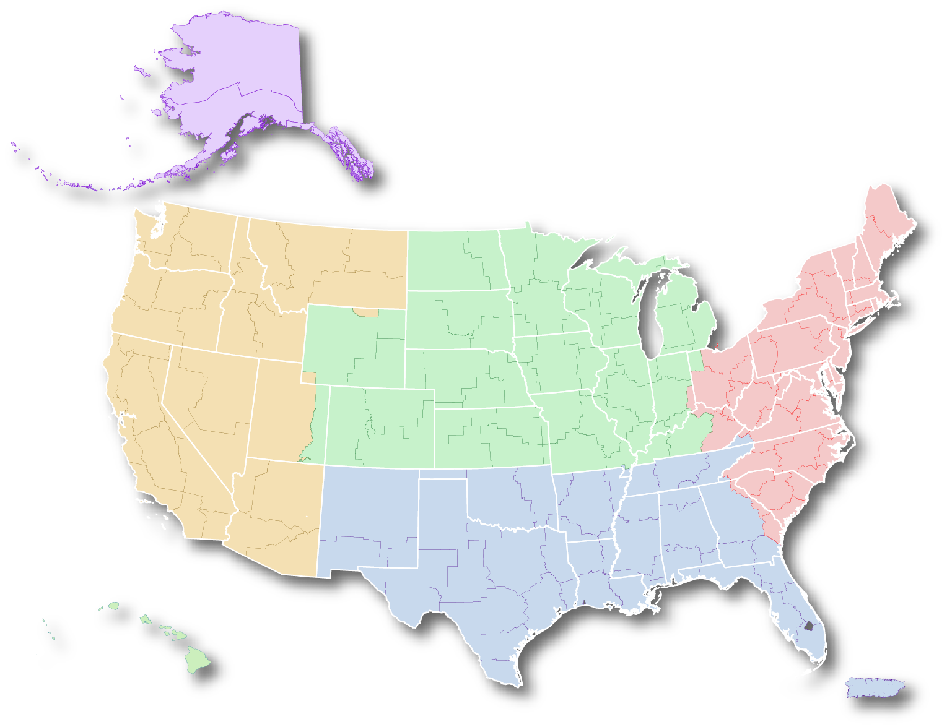
National Weather Service
has only 6 field regions, largest regions in most of US government
Alaska Region
Eastern U.S.
Western U.S.
Central U.S.
Southern U.S.
Pacific Region
Hawaii & Guam
Puerto Rico &
Virgin Islands

Slide 15
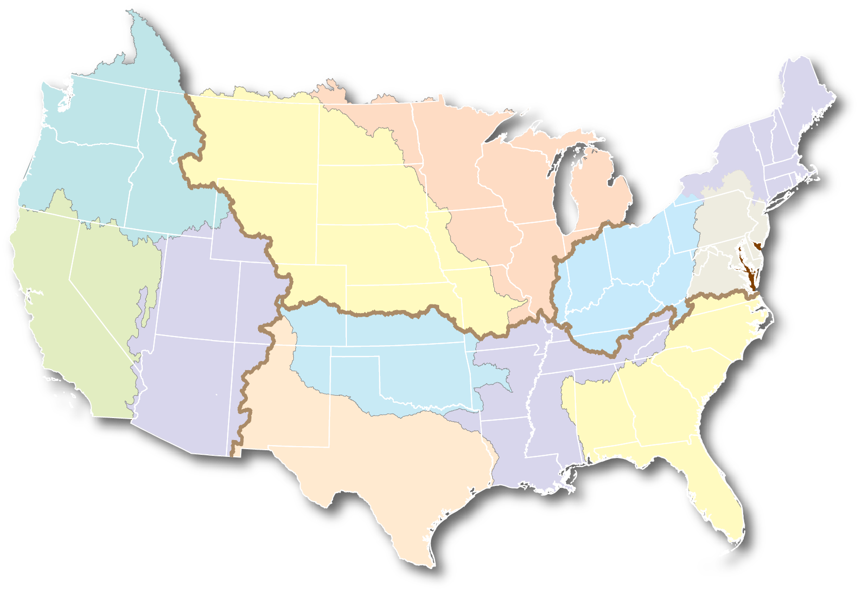
NWS River Forecast Center areal responsibilities are already quite large!
North
Central
River Forecast Center
Northeast
River Forecast Center
Northwest
River Forecast Center
Central
Eastern
Western
Missouri
Basin
River Forecast Center
Colorado
Basin
River Forecast Center
Ohio
River Forecast Center
Mid Atlantic
River Forecast Center
California
Nevada
River Forecast Center
Arkansas
Red-Basin
River Forecast Center
Southern
Southeast
River Forecast Center
West Gulf
River Forecast Center
Lower
Mississippi
River
River Forecast Center

Slide 16
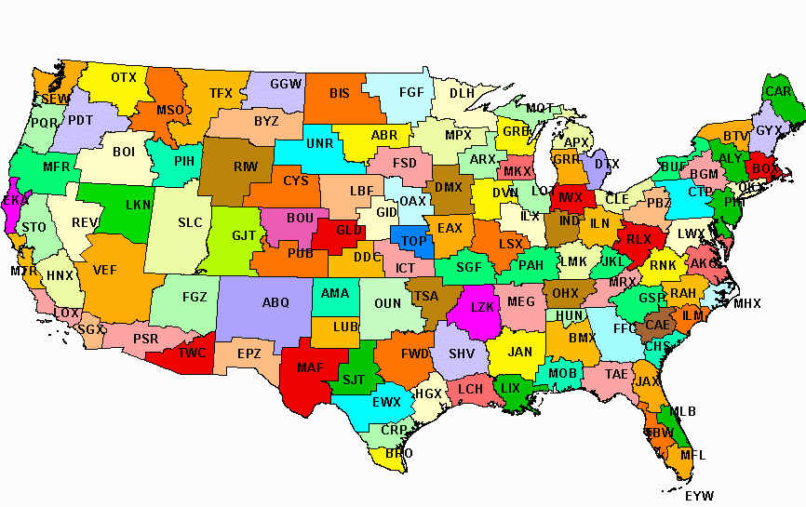
All-hazards “Risk to Life” is best served by weather services & warnings from nearby WFOs FCs !
NWS: 122 WFOs, 13 RFCs, 21 CWSUs
6 ROs, 25 WSOs, 9 NCEP Centers

Slide 17
NWS ‘90s Modernization Quadrupled Flash-Flood Warning Lead Times
60
Pre-local forecast offices
and pre-radar
(11 mins)
Doppler radars
Installed
(17 mins)
WFOs fully functional (45 mins)
50
40
30
Average Lead Time
20
10
0
87
88
89
90
91
92
93
94
95
96
97
98
99
00
01
02
03
04
05
Year
Notes:
Einstein said some of the most important things are the hardest to measure, for example: are we saving lives and how do we prove it?
Over a decade ago, your National Weather Service went through a significant modernization in technology and organization of its workforce.
Did it achieve measurable improvements? READ SLIDE

Slide 18
NWS ‘90s Modernization Tripled Tornado Warning Lead Times
WFOs become fully
Functional
(12 mins)
Pre-local
Forecast Offices
and
pre-radar
(4 mins)
Doppler radars
Installed
(6 mins)
Notes:
READ SLIDE

Slide 19
US National Weather Service
Offices, Centers, Regional Offices, CWSUs
122 WSFOs
13 RFCs
6 Regional Offices
1 National Headquarters
9 National Centers
21 Center Weather Service Units (FAA ARTCC)
9 Weather Service Offices
2 Tsunami Warnings Centers
1 Tsunami Information Center (Caribbean)
Space Flight Meteorology Group (JSC Houston)
FAA Academy Training Unit (FAA Oklahoma City)
U. S. Army Corps of Engineers Support

Slide 20
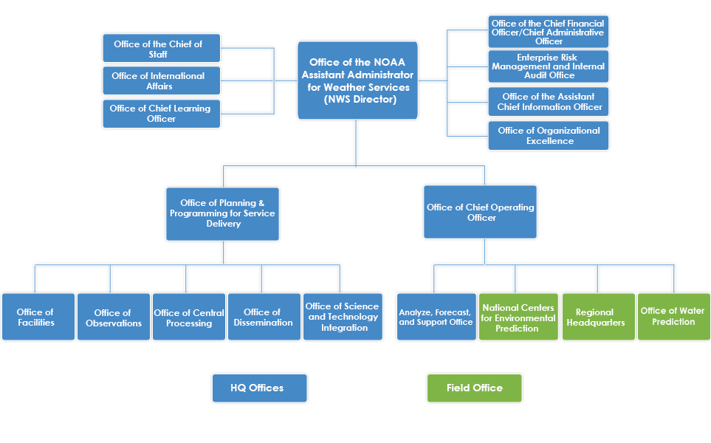
2015 newly organized NWS headquarters places mission delivery field offices further from NWS Director.

Slide 21
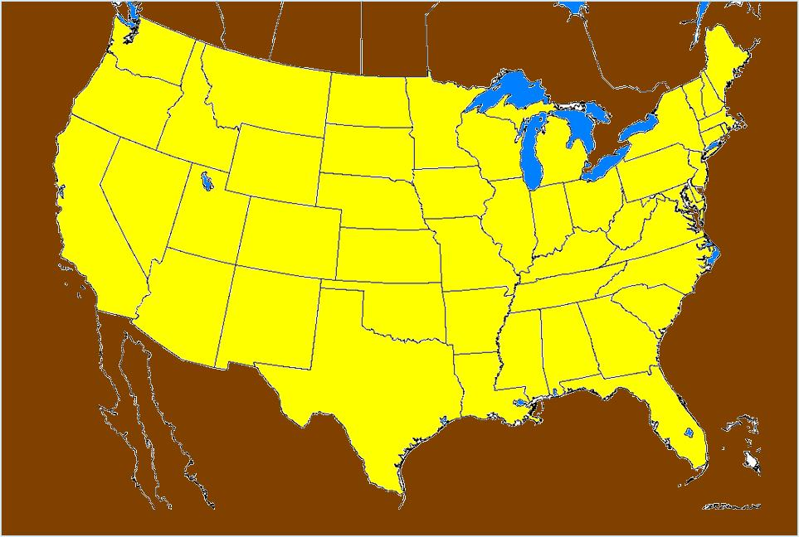
USA had 8386 Tornadoes in 6 years.
We are uniquely tornado vulnerable !
5
(2003 – 2008)
AK - 3
20
5
30
221
4
4
16
263
42
6
29
182
3
230
88
40
66
10
RI - 1
10
360
381
86
DE - 2
62
8
413
161
10
195
261
MD - 43
771
429
161
224
29
163
HI - 7
320
228
64
301
PR - 4
249
369
379
870
212
351
We are a confrontational ………….battleground:
continental vs tropical air. e.g. ’04: 1817; ‘08: 1690

Slide 22
USA has the most short fused warnings!
Total Warnings Issued in 2003
Notes:
In total, our offices give effective focus and detail to the NWS Mission delivery.
The importance of local expertise in our mission delivery is proven by the graph above.
In fact, we are one of the most performance rated agency in the Government. Field offices must show improvement over models and guidance and indeed they do.

Slide 23
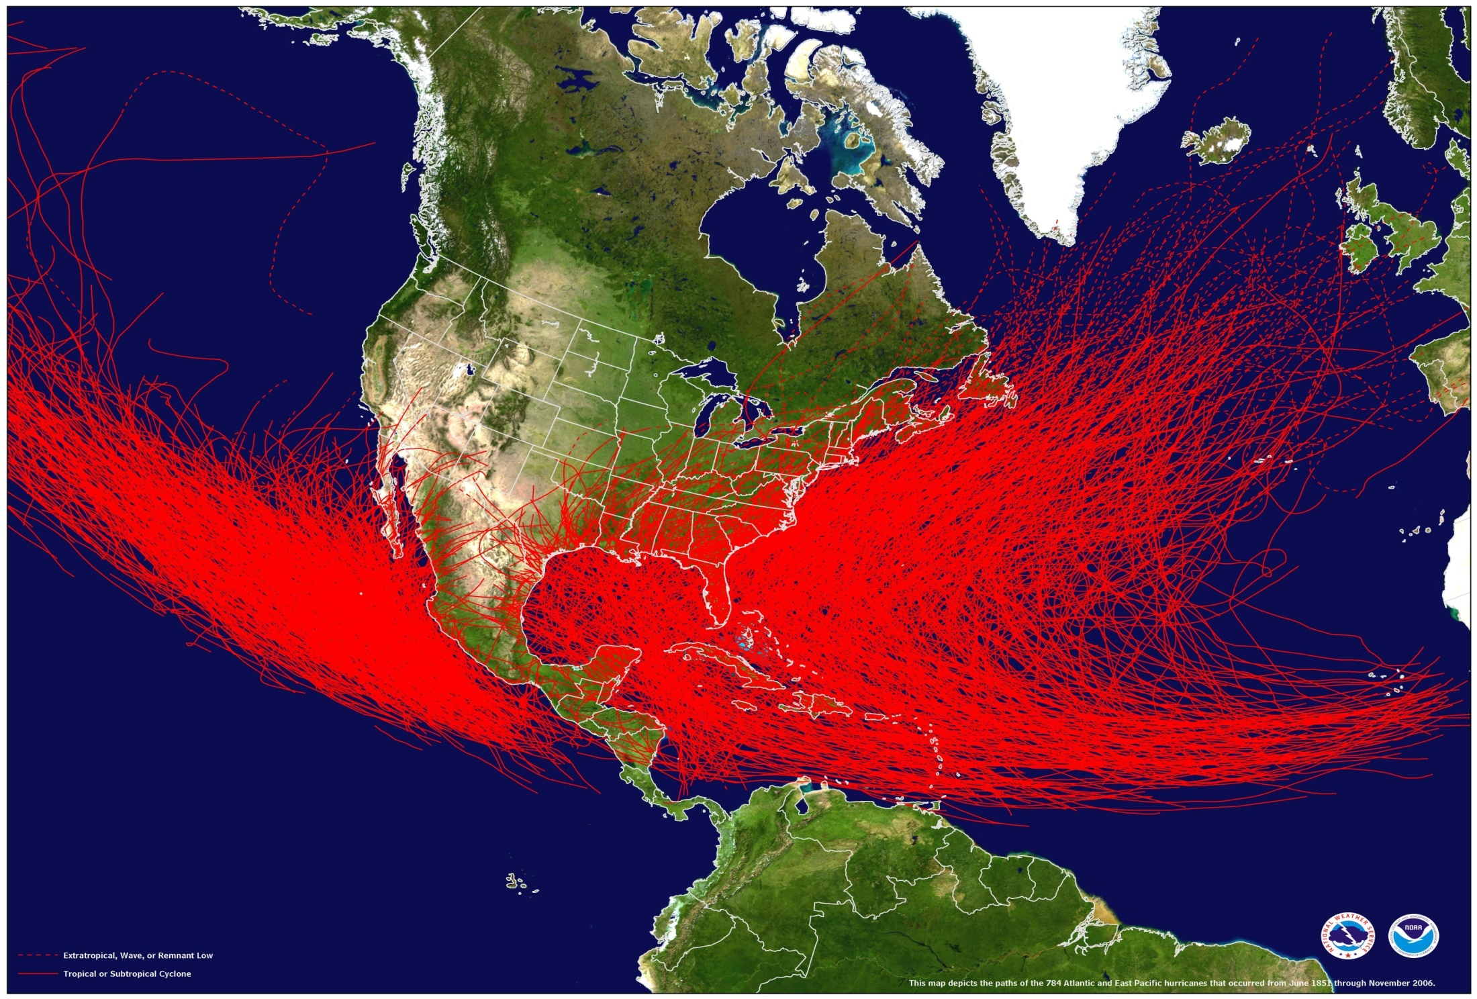
The U.S.A. is uniquely placed
to be hurricane vulnerable !
The Atlantic Basin has had over 1400 tropical cyclones since 1851

Slide 24
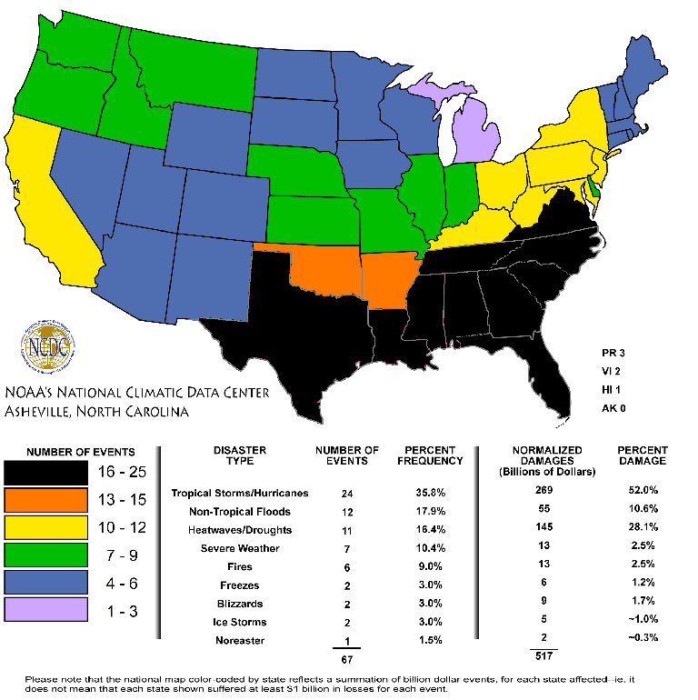
USA: Billion $ Events, 1980-2005

Slide 25
Annualized United States
Severe Weather Deaths
30 Year Average (1979-2008 NWS Storm Data)
Flash Floods and River Flooding…
… average annual deaths: 93
(however, flash floods kill the most: 73)
Lightning 58
Tornadoes 57
Hurricanes & Surge 48
Average annual deaths: 256
Notes:
We are an active severe weather nation. Considering how uniquely severe weather active we are in the world, our average death tolls represent some success in the protection of life. Flash floods are 78% of our flooding deaths. Flash Floods are our biggest killer and its growing, 1995-2009.

Slide 26
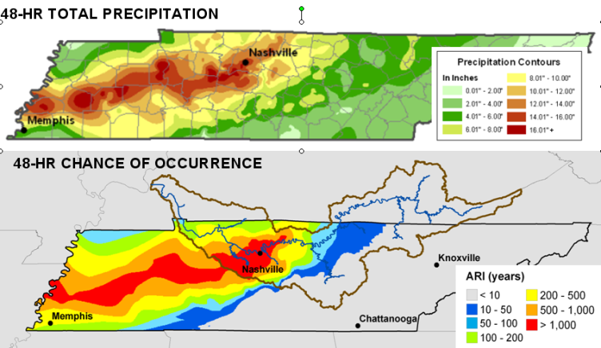
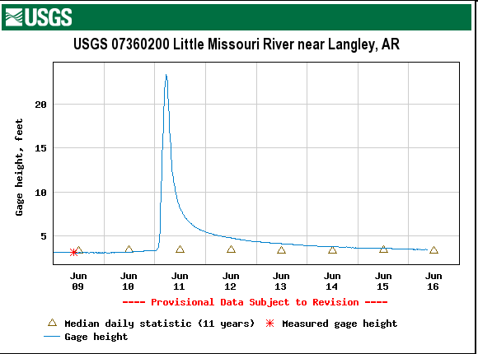
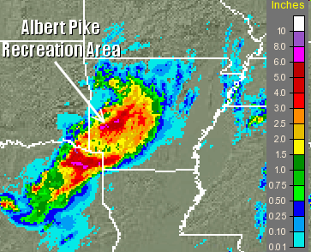
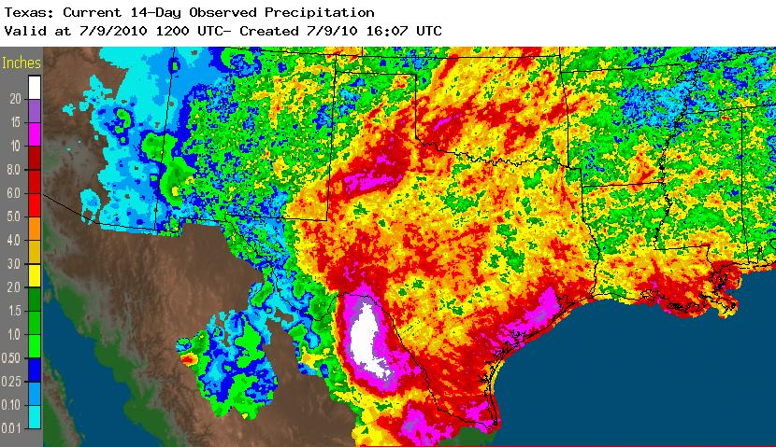
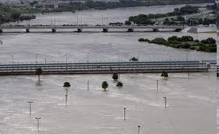
Local forecaster expertise & 24x7 awareness is critical to save lives in both severe weather and EM high impact events!
Nashville, TN May 1-3, 2010
  10-16 inches of rain in 48 hours
  31 fatalities
  $2.3 billion in damages
Arkansas June 11, 2010
  4-7 inches of rain in 24 hours most fell in about 6 hours
  20 fatalities
  $9 million in damages
  River rose 20 feet in just a few hours
South Texas July 2010
  Tropical moisture from Hurricane Alex and TD#2 caused more than 50 inches of rain over 10 days (in Mexico, Rio Grande Basin)
  $70 million in damages (preliminary estimate)
Notes:
The Southern US experiences and issues the greatest number of flash flood watches and warnings. This past year was certainly no exception as we see from these major flash flood events, all in the Southern Region. Indeed we are the confrontational battleground between continental air and unlimted amounts of moisture from our tropical air from the south.
Cumberland River Flood - Nashville, TN
Albert Pike Campground – Southwest Arkansas
Rio Grande Flood – South Texas

Slide 27
WFOs have a 24x7 realtime wealth of life saving info & data around the clock!!
Satellite
Data
Local & Nat’l
Radar Data
NCEP
Guidance
Local
Modeling
Surface Obs &
Buoy Data
Nat’l & Local
Upper Air Data
RFC
Guidance
Storm Spotters
& Amateur Radio
WFOs, RFCs, WSOs, CWSUs,
NCEP Centers, Rgnl Ops Centers
CWSUs &
Aviation Wx
CO-OP and
Mesonet Data
Regional Web
Farms & social blogs
Partners, Public, Private
Notes:
No one can serve your weather needs better than your local WFO. The modernized Weather Forecast Offices harvest weather data at all levels especially at the finer, mesoscale…local level.

Slide 28
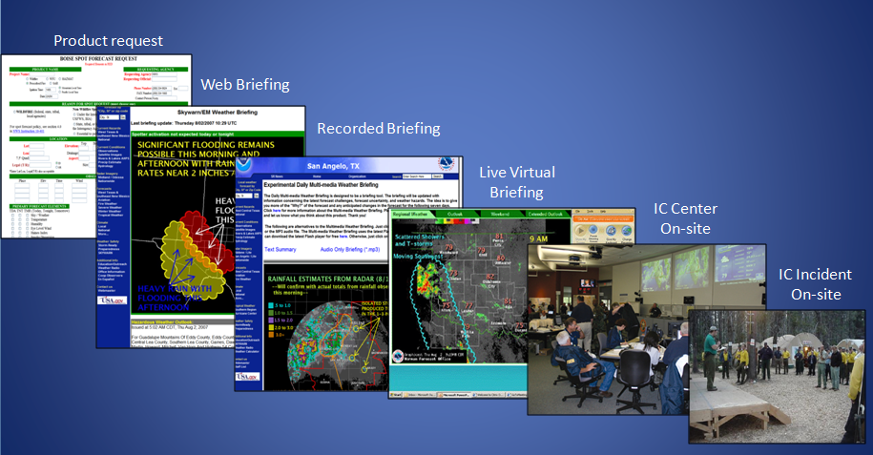
So NWS, with its 24x7 national network of LOCAL WFOs best meets national needs.
Specifically, local WFOs provide area focused/direct on-site all-hazards weather info in multi-faceted ways with the latest communications technology.
Notes:
So better NWS decision services/graphics, the ER-MET concept, better technology for all events, “but it takes…”
READ RED LTRS

Slide 29

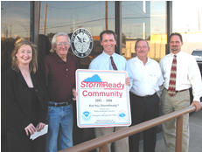
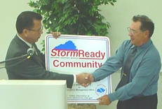
Storm-Ready and Tsunami Ready LOCAL Warning Programs
Began in Tulsa - 1998
Began in PR & HI & AK - 2007
2528 NATIONWIDE sites!!
Improves community weather and tsunami preparedness
US NWS-WIDE
begun by local initiative!

Slide 30
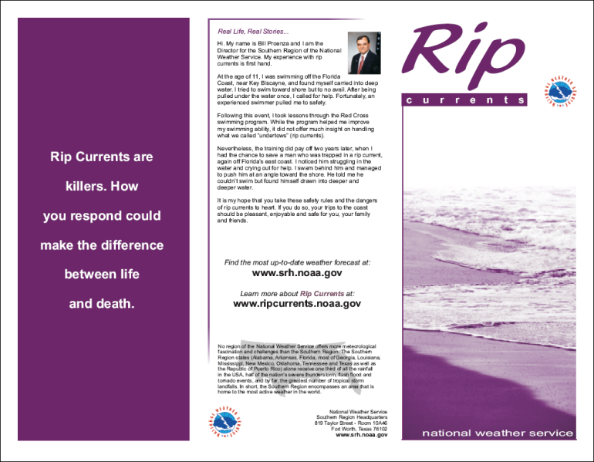
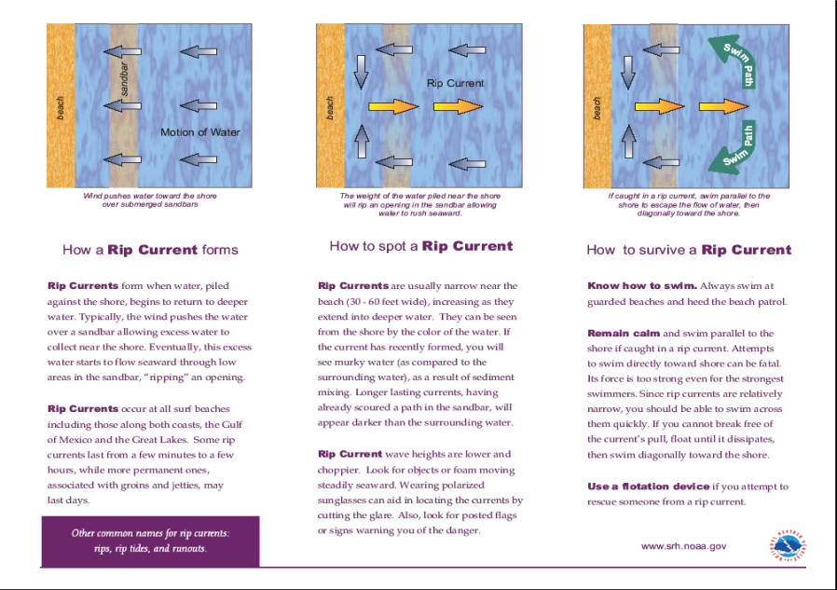
NWS RIP-Current Warnings, save lives!
Program conceived and implemented at WFO Miami
SR implemented an aggressive RIP Current Awareness Campaign
Campaign included talks, brochures, and other outreach to warn public of hidden dangers
Program now national
Another LOCAL WFO initiative, now National!
http://www.ripcurrents.noaa.gov/

Slide 31
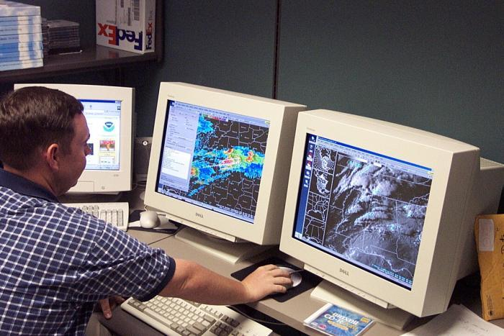
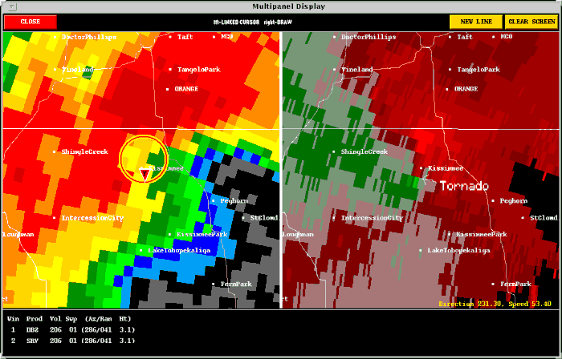
Weather Event Simulator
Developed in 2001
Simulates significant weather events
Enables LOCAL forecast offices to build case studies on LOCAL hazardous weather
Increases mesoscale warning expertise of LOCAL NWS forecasters
Another LOCAL office initiative from 24x7 local offices now National!

Slide 32
WFO Post Storm Reports
LOCAL WFOs compile an official historical record of severe weather conditions.
Such summaries include . . . Tornado surveys, rain storms and flash flooding, windstorms, storm surge, river flooding, casualties and damages.
Vital for the Nation’s EM disaster documentations and Presidential declarations.
Notes:
So better NWS decision services and graphics, the ER-MET concept, better technology all possibilities, “but it takes…” READ RED SLIDE

Slide 33



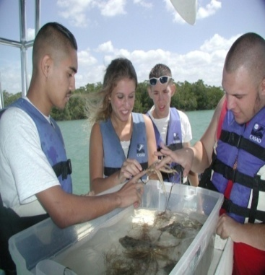
24x7 WFO/RFC/WSOs is the proven Weather Ready Nation Network !
Our Nation is far better protected from life-threatening natural and unnatural events by a 24x7 local area office network!
Enables a nationally designed response to climate variability
Better handle on water availability for life, homes, industry, agriculture, ecosystems, and recreation
Enables our local expertise to enhance local environmental information for unlimited economic benefit and productivity
AND Better protection of life , natural habitats, biodiversity
Weather/Climate
Water
Space
Environment
Ecosystem
Notes:
33
33
These are the desired outcomes.

Slide 34
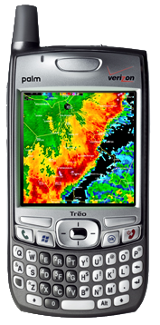
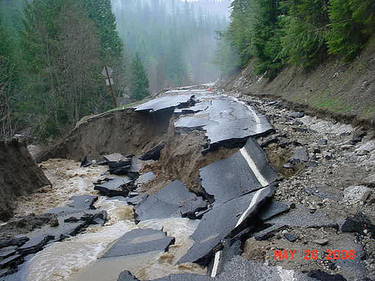
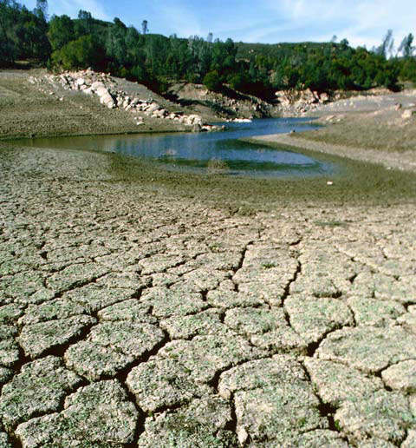
National requirements: 24x7 Decision Support!
LOCAL Decision Support products and services for all hydro-meteorological phenomena or high impact events.
  Severe weather warnings for life threatening events
  Climate Drought and Water Resource Services
  Flash Flooding warnings and River/water mgmt.
Delivered in close collaboration with NWS partners, stakeholders
Notes:
34
The road which NWS is heading.

Slide 35
A far better US NWS future for life saving decisions & support while maintaining the tried & proven services
Emergency Response Meteorologists (“ER-METS”) allows a renewed infusion of science & tech while allowing new technologies. Saves lives and provides greater National resiliency!
Who: A better trained all-hazard NWS workforce
Where: Delivering services to Emergency Managers, First Responders , Water Managers and River Authorities.
What: 24x7 hydro-meteorology warnings plus high impact weather support to EMs, media, local officails.

Slide 36
But “fair-weather staffed” NWS field offices are dangerously understaffed by NOAA’s slow recruiting since Fall 2011 !!
  The NWS field offices are at a crisis understaffing with over 600 vacancies. Contrived slow recruiting coupled with fair weather staffing is stretching field people resources to the point that overworked employees are dangerously fatigued. Adequate funds are appropriated for the missing 600 positions. If all these resources can be immediately placed into field offices (WFO) and filled, each WFO would be enabled to deploy or dedicate a forecaster 24x7 to DHS/EM/local govt. for high impact events.
  Furthermore, full staffing will allow:
  vital science infusion in both equipment (better utility of atmospheric models for WFO field forecasters) and…
  training opportunities to expand and move the agency away from the current & dangerous minimal training levels.
  Overall protection of life mission improves nationwide.

Slide 37
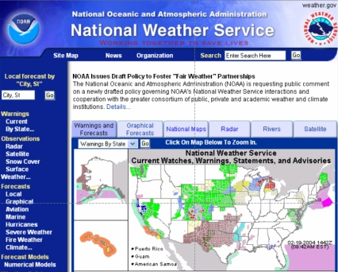
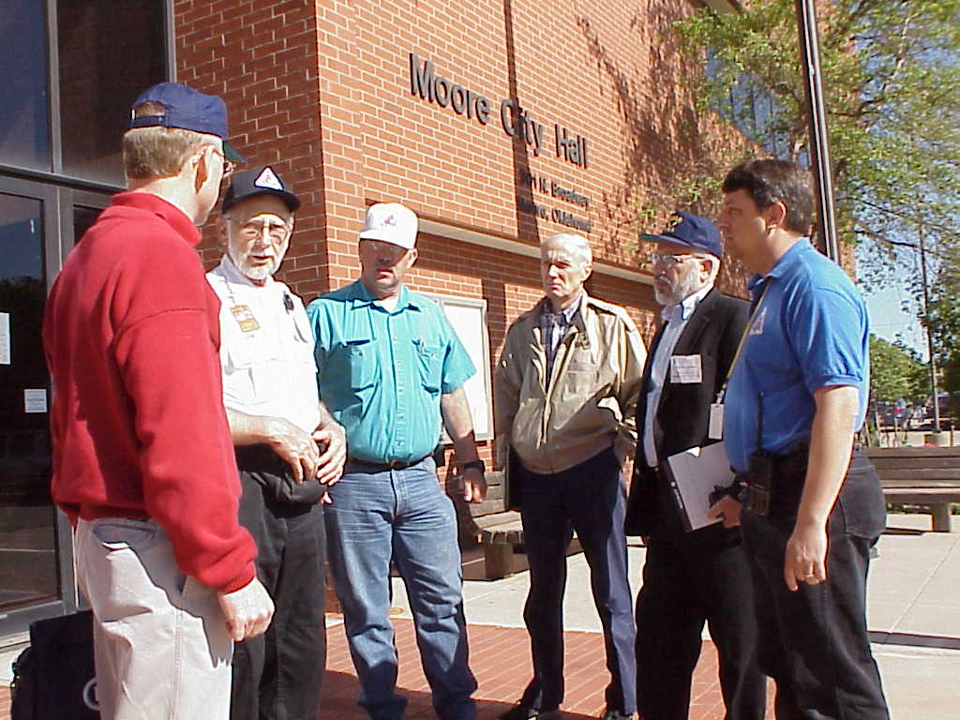
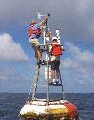
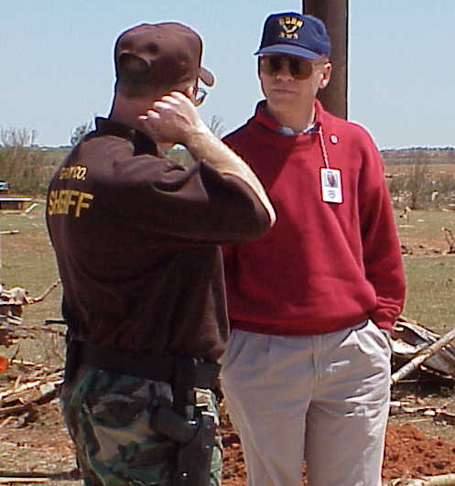
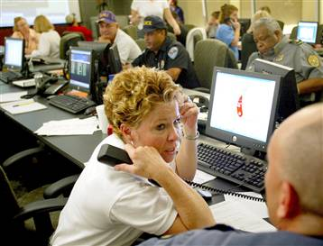
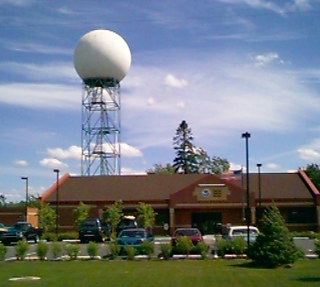
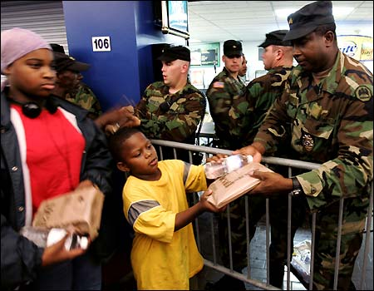

NWS 24x7 Decision Support Services
Saves Lives and Provides Economic Wellbeing through Partnerships
OUR VITAL
PARTNERS !
COMMUNITY
PROTECTION
YOUR NWS TEAM
Notes:
It takes a team to be successful in this business. We in the NWS work closely together with our partners in emergency management, the news media, and others, to help protect Americans from all walks of life.

Slide 38
NWS 24x7 WFO/RFC/WSO have proven local & direct weather support for state & local government, EM decision-makers, first responders and partners… for the most resilient all-hazards Homeland!
Such LOCAL NWS services epitomizes the concept:
…weather services closest to the people, serves best!
Bill Proenza, Retired Regional Director
National Weather Service

