Slide 1
NCEP Annual Operating Plan Meeting: Evolve NWS PMO
BRIEFING
February 14, 2017
CONFIDENTIAL AND PROPRIETARY Any use of this material without specific permission is strictly prohibited

Slide 2
Contents – objectives for today’s discussion
Review the history of Evolve NWS
Review PMO activities supporting implementation
Discuss future working relationship

Slide 3
Contents – objectives for today’s discussion
Review the history of Evolve NWS
Review PMO activities supporting implementation
Discuss future working relationship

Slide 4
Evolve NWS born out of NAS and NAPA studies in 2012 and 2013
NAS (2012), NAPA (2013)
studies
Phase I
Phase II
Phase
III & IV
Strategy Study
Phase V
Timing
2015 MAY – AUG
2015 SEP – DEC
2015 DEC – 2016 SEP
2016 AUG – 2016 DEC
2016 OCT – present
Key Activities
Launch of teams and ideation
Bring to Scale, Adapt and Expand
Diagnostic
Idea Refinement
Strategic Landscape
OWA “outside-in” diagnostic on baseline and gaps across workforce, org. structure, and operating model, including Organizational Health Index (OHI)
Launch workstream teams across all office types, generate ideas, & develop recommendations
Design “Fully Integrated Field Structure” concept and strategic staffing blueprint, prioritize ideas, and gather feedback from internal and external stakeholders
Refresh understanding of NWS’s external context, research changes in private sector, and assess options for role of government to best meet mission
Operationalize tested and refined recommendations; implement across entire organization
Key Decision Points
Focus on Weather-Ready Nation Vision and shift to a science-based service model
Decision to work in parallel on:
Actionable ideas
Blueprint for the future state workforce, org. structure, op. model
Shared diagnostic findings internally and externally (e.g. Hill, OMB, NWA, IAEM, NAPA, NAS, AMS)
Creation of workstream teams
Regular communications
Workforce
GS 5-12 Met. Dev. Model
NWS 101 and Manager Orientation
Operating model
IDSS “deep relationships” philosophy – to be used in clarifying IDSS policy
IDSS training
Org. structure
NSP role clarity, Tsunami alignment, Field Leadership Committee
Collaborative Forecast Process (CFP) based on NBM
IDSS table top exercise
Fully Integrated Field Structure concept, with defined roles across office types
Strategic staffing blueprint, with criteria for estimating workforce needs by office and future state office maps
Workforce model tools
OHI “culture team” launched in OOE
Designate OOE as external engagement lead for communications and research
Interview major industry players
Engage leadership in scenario planning workshops
Write paper with perspective on changes in enterprise
Engage with portfolio leads in understanding opportunities and risks from private sector change
Establishment of PMO as Evolve NWS leader and connection between “left side” and “right side” of organization
Evolve NWS as the organization’s #1 priority, to be reflected in AOP and resourcing decisions
Focus on five objectives
Focus on 16 initiatives
Objective Leaders and Implementation Leaders in process of being named

Slide 5
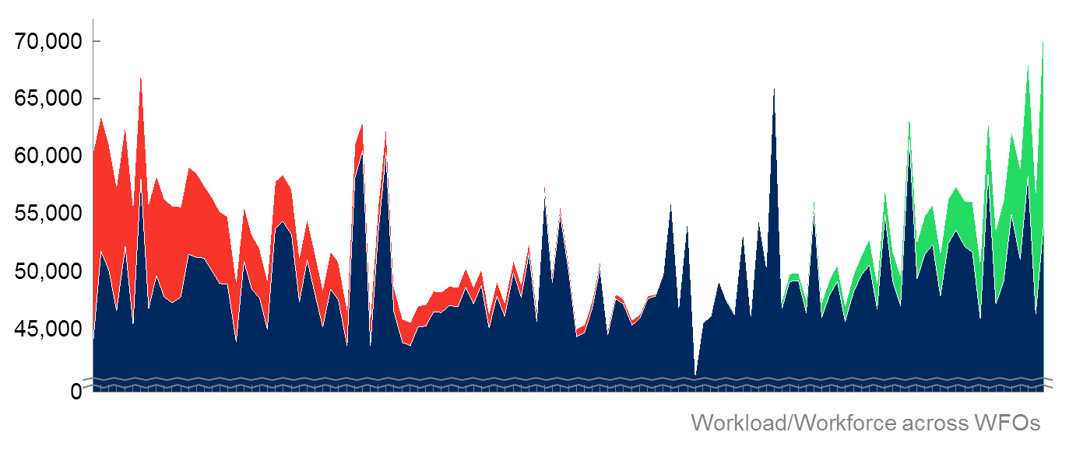
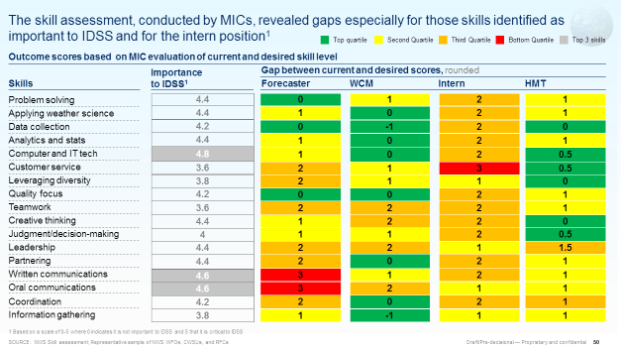
OWA studied NWS’s workforce, organizational structure and operating model, providing data supporting potential required evolution for delivering Weather-Ready Nation Vision
Key insights
Workforce
Controlling for differences, there is a mismatch in some areas between today’s workforce and today’s workload
In addition, there is a difference between the current and desired skill level for skills identified as important to IDSS, including written and oral communications
Org. structure
Though NWS ranked very highly in terms of motivation and external orientation, potential opportunities for improvement exist both in terms of health – where NWS scored lower on overall health than other public and private organizations – and structure – where HQ has reorganized, but the field remained constant, lacking role clarity across national, regional & local offices
Spans of control vary across the organization, being larger than peer organizations in several important management levels, making coaching and training difficult
Operating model
Though generally high customer satisfaction was observed, IDSS is inconsistently delivered, including in terms of what IDSS products are provided, how IDSS is delivered, when IDSS is delivered and to whom IDSS is being delivered
The forecast process today involves some duplication of effort and results in inconsistent messages and may not make best use of emerging technological developments
Notes:
Site visit list:
Eastern
Taunton, MA (WFO, NERFC)
Cleveland, OH (WFO)
Charleston, SC (WFO)
Southern
Ft Worth, TX (WFO, CWSU, WGRFC, RHQ)
Key West, FL (WFO)
Miami, FL (WFO, CWSU)
Norman, OK (WFO)
Pacific
Honolulu & Hilo, HI (WFO, RHQ, ITIC, PTWC, DCO, CPHC)
Central
Grand Forks, ND (WFO)
Kansas City & Pleasant Hill, MO (WFO, RHQ, NWSTC/OPG, MBRFC)
Western
Boise, ID (WFO, NIFC)
Elko, NV (WFO)
Sacramento, CA (WFO, CNRFC)
Seattle, WA (WFO, CWSU)
Alaska
Anchorage & Palmer (WFO, RHQ, APRFC, NTWC, AAWU)
Fairbanks (WFO)
Other
NCEP (SPC, NHC, AWC, EMC, WPC) in College Park, MD; Miami, FL; Norman, OK; and Kansas City, MO
Plus, during later phases, each regional HQ was visited, plus Slidell WFO and RFC, Minneapolis WFO, Las Vegas WFO, and Chanhassen location of NWC

Slide 6
Comprehensive Evolve strategy based on three pillars: deeper service to core partners, cutting-edge scientific capabilities, and strategic engagement with the enterprise
What we are doing to Evolve NWS
How we manage it
Build the Roadmap into a phasing diagram and placemat for near and long-term planning
Incorporate into the Annual budget planning and Annual Operating Plan
Integrate organization health and culture initiatives (OHI, FEVS)
Updated Strategic Plan to build a weather-ready nation and enable NWS to best meet its mission
Deepening our service to core partners: Implement Operations and Workforce Analysis (OWA) recommendations and tests (transferred to PMO)
Engaging strategically with the broader enterprise:
Proactively harness external advances in that benefit the mission and enable the enterprise to grow
Enhancing our science and technology capabilities: Ensure NWS operational infrastructure remains at the cutting edge (e.g., through developing a modeling plan)
Implemented through updated NWS Roadmap and comprehensive Impacts Catalogue

Slide 7
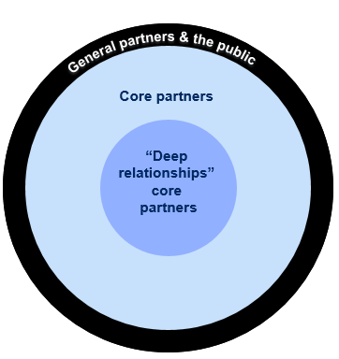
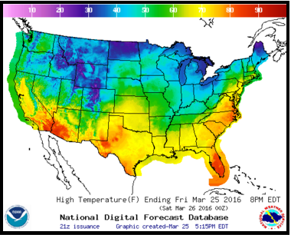
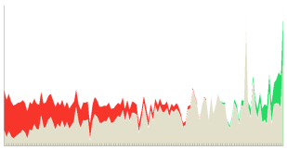
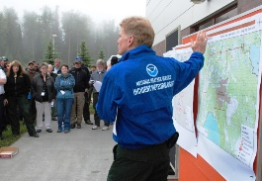
OWA diagnostic led to a vision for how NWS can achieve a Weather-Ready Nation
From today…
To the future…
How
Variation in partners served
Deep Relationships IDSS
Defined IDSS partner types
Inconsistencies in forecast, duplication of effort without best use of technology
Collaborative Forecast Process
Clear roles supported by technology to create information partners need
One-size-fits-all staffing mismatched with demand
Strategic Staffing and Organization
Workforce aligned to workload, with supporting org. structure
Production-oriented workforce trained only in science
Create a workforce of tomorrow
Diverse, versatile workforce trained in science-based service model
Org. not best positioned to take advantage of innovations in science and technology
Science, Technology to support field
Field structure is supported with needed science, technology, and innovation to meet mission

Slide 8
Improving service to partners through IDSS, with the goal of building a Weather-Ready Nation
Diagnostic findings
Vision
From inconsistent service that at times doesn’t go “beyond the forecast” to explain impacts to partners
To consistent levels of decision support before, during and after events, focused on “deep relationships” partners
Core service level
Similar products are disseminated by different entities in NWS
Offices make decisions about whether to provide recurring or episodic IDSS services without a framework of prioritization criteria
Partners know what standard products and services are offered by different NWS offices and when to expect them – before, during, and after events
Local NWS offices know what partners need for key decision points and are able to tailor messages to support decision-making
Partners served
General partners
There is significant variation in who is provided IDSS and how the definition of core partner is applied
Core partners
Offices define core partners with similar criteria allowing decision support to be more consistently offered throughout the organization
“Deep relationships”
Core partners
SOURCE: Interviews and job shadowing during ~40 office site visits from May 2015 – January 2016, OWA IDSS team, April 2016

Slide 9
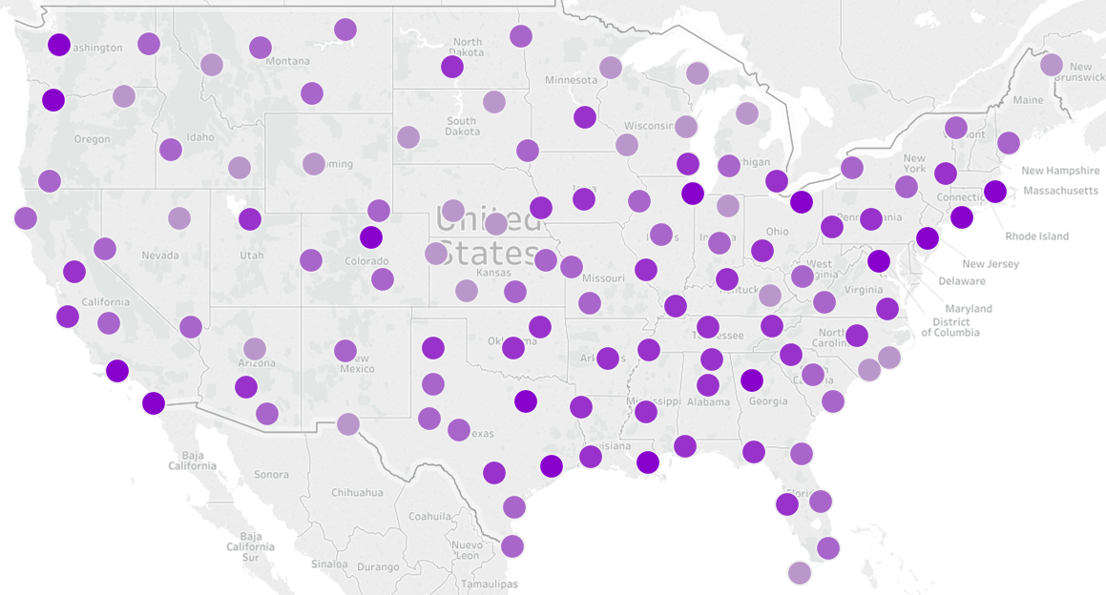
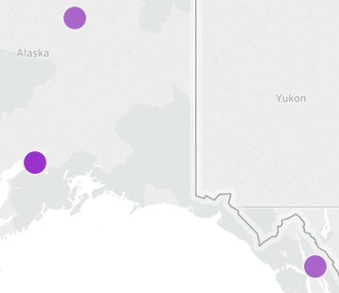
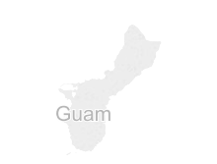
The current service-delivery operating model does not meet growing need for IDSS
Additional need for IDSS beyond what is provided today
Preliminary estimate of IDSS needs vs current IDSS capacity by WFO¹
Low
Extreme
More ecological IDSS opportunities in Great Lakes region
More IDSS efforts focused on flood frequency and severity in the Upper Plains
Every NWS office serves partners with IDSS needs, however the level of need varies across offices
Better serving partners by enhancing quality and consistency of IDSS at all levels of the organization, in all current locations because analysis shows 94% of partners are local partners¹ – no office closures
Port Authority of NYC expressed need for additional support
Montana state EM could benefit from co-located fire expert
Additional opportunity to work with Flood Control Districts and Water Districts
CDC in Atlanta interested in additional support
NORTHCOM Alaska expressed need for additional support
Support to One NOAA through ecological forecasting services
Maui County could use in-person support more often than it receives now
1 NWS IDSS core and deep partners identified through national training, data call, and review May – July 2016
SOURCE: OWA Strategic staffing team

Slide 10
As flexibility is unlocked over time, NWS will move positions to areas of greatest need, and ensure that all partners receive as much or more support as they do today
Conceptual diagram for strategic staffing
Criteria to use in estimating strategic staffing across all frontline field offices
Leadership &
administration
Overall size of office
Best practice manager-to-employee ratio of 6-8 staff per manager
Science & training
Number of operational staff
Proximity to / relationship with universities, other NOAA offices
Presence will be maintained in all offices, and NWS will use a comprehensive methodology to evaluate when and where to move positions to match workload
Systems support
Number of ASOS, radar, COOP, upper air sites, river gauges
Distance to / ease of access to observation sites
Products and systems supported or developed on-site
Science-based service through Impact-based decision support services (IDSS), based on observations & forecast analysis, to support
“ready, responsive, resilient”
Population, property, and infrastructure
Weather, water, climate impact
Frequency of need
Vulnerability
Core and deep partners
Met watch mutual aid & situational awareness
Frequency of hazardous weather and water activity
Role in supporting met watch mutual aid across offices
Use of latest advances for situational awareness i.e. HRRRv2, FACETS
Collaborative forecast production
State of model guidance for the service area and/or geography
Future office functions
SOURCE: Strategic staffing team preliminary output, May 2016

Slide 11
Developing a collaborative forecast process that results in a common operating picture is critical for improving IDSS
Diagnostic findings
Vision
From multiple forecasts…
…to a common operating picture
The goal is one event, one forecast – because multiple forecasts is no forecast at all
WFOs, RFCs, and NCEP overlap at times resulting in inconsistent forecasts and duplicated effort
Many forecasters manually determine which models to use
Forecasts may contain “seams”
Each office is not fully leveraging all the expertise NWS has to offer
Clear roles and responsibilities for each field office
Common operating picture for the forecast produced at NCEP & NWC, based on the National Blend of Models and National Water Model, and increasingly probabilistic
Seamless forecast for partners, with local detail incorporated where it matters most for IDSS
Expertise across NWS layered on to the forecast and message
SOURCE: NWS interviews Jan – Mar 2016; OWA Fully Integrated Field Structure team working session April 2016

Slide 12
Each idea contributes to flexibility needed to meet WRN needs
Relative amount of flexibility contributed by each “unlock”
If in the future all offices are still 24/7/365 with two people required per shift, NWS loses significant flexibility – and organizational health issues will not be addressed
100% met
~60% met
Strategic staffing need
Collaborative forecast process
GS5-12 career progression
Autolaunchers
Met watch mutual aid for shift scheduling flexibility
Flexibility unlocked
Staffing level flexibility
Strategic positioning
1
2
3
4
5
6
7
Functional changes provide flexibility
Form changes allow NWS to use flexibility
SOURCE: OWA Strategic staffing team
Notes:
+So how does this fit together? Each of these time “unlocks” provides critical staff time flexibility needed for us to change how our we spend our time and enable us to deepen our service to partners
+Recall that we are trying to build up to 900-1200 staff worth of time flexibility - we estimated how much each idea gets us towards the goal, depicted here.
+You can see that the collaborative forecast process is extremely important to improving flexibility, as is finding a way to provide met watch mutual aid so that not all offices have to be 24/7/365
+These functional changes build up our flexibility so that we can align resources as needed for strategic staffing.
+The form changes –staffing the right number of people to each shift, and in the right places – is essential to using that flexibility in a smart way
+ But these unlocks to help free up time and resources don’t work independently; they are linked. If we don’t couple unlocks 2 through 5 on function with those on form we may not be able to fully meet our partners IDSS need.
Chart Breakdown:
1. The dark blue bar represents how much flexibility we need to strategically align our staff across the field, and to use their time on the highest value activities
2. You are aware of the collab forecast process idea, building on the NBM – changing forecast production requirements on WFOs could save significant time – already offices report that with the limited blend technology they have today they can save ~2 hours per shift. We are going to build on that success through the NBM.
3. You might not be aware that today we have some of our meteorologists working as “Interns”, limited in the duties they can take on. By developing a single GS5-12 career progression we can advance more mets through training and help them add as much to the office and their partners as they are capable of
4. Hopefully you have heard of our opportunity to install autolaunchers to replace manual weather balloon launches. We currently have highly skilled mets launching weather balloons twice a day in many of our offices, when instead they could be working with partners. If we don’t change this, we lose flexibility in when offices have to be open as well – which would make that bar for autolaunchers even higher.
5. Met watch mutual aid is an idea that would allow us to have some offices close during part of the day when the weather is fair and partners don’t need us. We would match our schedules to our partner’s schedules, while ensuring there is always a 24/7/365 expert watch point that is familiar with the area. This will require a change in how our offices work together that goes beyond providing backup when service is down – we don’ t know yet precisely what the solution will look like: it could be met watch handovers between offices in fair weather or it could be some offices taking on the met watch role for a larger area continuously. We have to test to find out, and we will build on models that work today – at our own RFCs, with our IMETs, at hospitals and fire stations.
Ideas 6 and 7 are critically important and underpin all the flexibility the other unlocks give us – if we can’t allow 1 person to be on duty, and if we don’t have our people in the right places, we have freed up hours, but not at a time of day we can use it to help partners.

Slide 13
Contents – objectives for today’s discussion
Review the history of Evolve NWS
Review PMO activities supporting implementation
Discuss future working relationship

Slide 14
Vision for Evolving the NWS: five objectives
NWS Mission
To provide weather, water, and climate data, forecasts and warnings, for the protection of life and property and the enhancement of the national economy
Vulnerability of the American population to severe weather events
Need for NWS services among deep core and core partners
Ongoing need to continue to meet the mission of the NWS
Why evolve?
The NWS is evolving to better meet the mission through five objectives:
Better serving partners by enhancing quality and consistency of IDSS at all levels of the organization, in all current locations because analysis shows 94% of partners are local
Building a flexible and nimble workforce the NWS needs to deliver science-based services: both through enhancing skills today and hiring for tomorrow
Improving effectiveness of forecasting in support of IDSS through a collaborative process that makes the best use of technology, reduces duplication, and ensures consistency of the forecast
Matching workforce to workload across the organization and building a stronger organizational structure to better meet the needs of NWS partners
Supporting the innovation, science, technology, and culture required for NWS to continue improving over time

Slide 15
Why did we create a Program Management Office (PMO) and what does it do?
Why create a PMO?
What is a PMO?
The OWA diagnostic and the Organizational Health Index identified a need for a body to help coordinate change efforts across the organization
The NWS Program Management Office coordinates, tracks, and supports all actionable ideas generated by the OWA to ensure they are further developed, resourced, and executed
OWA “actionable ideas” often stretch across Regions and functions
Ideas may require coordination across many different offices and portfolios
PMO will include staff from both “sides” of the organization, including a robust field presence on initiative teams and within the advisory structure
Executive champion for the PMO will be Kevin Cooley, with Grant Cooper as his “co-pilot” in the advisory chair position
Full time project managers will be staffed to the PMO in order to support OWA initiatives as they move through testing to implementation

Slide 16
PMO manages Evolve NWS
Office of the Assistant Administrator
For Weather Services
The PMO sits under the Office of Programming and Planning for Service Delivery
OPPSD
COO¹
PMO
Responsibility for the execution of Evolve rests with the Executive Sponsor, OPPSD Director Kevin Cooley
Executive Sponsor
Advisory chair
The PMO is supported by an advisory structure, lead by a field SES and including a board of respected field leaders
Support functions
PMO director
Advisory Board
The PMO works closely with internal stakeholders such as communications, labor relations, risk management, social science, etc
Deputy
NWS liaisons (comms, LMR)
PMO-led initiatives are divided among Objective Leads, who are responsible for ensuring their initiatives deliver on a key strategic objective of Evolve
Science & technology
Forecast process
Operating model
Workforce
IDSS
Initiative teams are composed of a mix of field and HQ personnel, and are supported by the PMO in rigorous planning and structuring of their task
Initiative teams
Initiative teams
Initiative teams
Initiative teams
Initiative teams
SOURCE:

Slide 17
How teams work in the PMO?
Operations & Workforce Analysis
Evolve NWS
Actionable ideas
Evolve initiatives
OWA teams identified 40+ “actionable ideas” – concrete ideas the NWS could explore, test, and implement to improve forecast production and better support partners in protecting lives and property
The PMO leadership team reviewed, sorted, and synthesized these ideas into 40+ potential initiatives
These initiatives have been grouped into projects, prioritized, and each has a dedicated team staffed against them
Team structures
Team structures
OWA teams were comprised of many different people, and were focused on idea generation across a broad content area
Evolve teams are generally smaller, and focused on detailed development, testing, and execution of a particular idea generated by the OWA process

Slide 18
High-level overview of initiatives to move out against in 2017
Improve effectiveness of forecasting in support of IDSS (CFP)
Enhancing quality and consistency of IDSS
Match workforce to workload
(org. structure)
Support Innovation, Science & Technology
Build Workforce to deliver science based service
Evolve NWS 1.0
I1. IDSS Planning and core service level
I2. Develop and refine IDSS policy guidelines
I3. Measuring IDSS impact
I5. IDSS training development
I6. Impacts catalog
W1. 1340 GS 5-12 career progression
F1. NBM field operation demo
F2. NBM V3.0 development
F3/I4. HazSimp
O1. ROC Roles and stand-up
O2. Future operating model demo
O3. Aviation strategic staffing
O4. Regional and Local time unlock tests
O5. Evaluate autolauncher staff time impact
S1. Use auto-launchers to automate upper air balloon launches
S2. N-AWIPS/ AWIPS integration
Note: Key initiatives in blue

Slide 19
PMO Relationship to NWS Governance
EC
Strategic Decision Making
Comms with senior NOAA/DOC leadership
Assist in Execution & Integration
Chief Engineer Engagement
MDC
Assess & Prioritize Requirements
PIC
PMO
PMO
ERC
Evaluate Strategic Risk

Slide 20
Program Management Office Charter
Scope and Authority
The NWS Executive Council (EC) authorizes the Program Management Office, under the leadership of the Director of OPPSD, to oversee and guide initiatives and projects to evolve NWS. The PMO is responsible for the day-to-day execution of the projects and initiatives and for routine decision-making.
Executive Sponsor
The Executive Sponsor of the PMO is the Director of the Office of Planning and Programming for Service Delivery.
PMO Organizational Structure
The Program Director reports to the Executive Sponsor, who is a member of the NWS Executive Council and liaison to the EC for PMO related matters. The Executive Sponsor, in collaboration with the Advisory Chair, who is an Executive from the Office of Chief Operating Officer’s organization, provides senior leadership and guidance to the PMO. Additionally, the PMO receives subject matter expertise and consultative advice from the Advisory Board, whose membership consisting of, at a minimum, a manager from each region and NCEP, as designated by the Advisory Chair.
DRAFT

Slide 21
Contents – objectives for today’s discussion
Review the history of Evolve NWS
Review PMO activities supporting implementation
Discuss future working relationship

Slide 22
Discussion: establishing a collaborative working relationship
How can we support each other going forward?
How do we ensure we are developing the “right” thing(s)?
What are our hurdles and how do we manage them?

Slide 23
Appendix

Slide 24
Evolve NWS will result in increased staff time for supporting partner decision-making, which is critical to our public safety mission, delivered at the local, state, and national levels
ILLUSTRATIVE
Diagnostic findings
Vision
From siloed production…
…to science-based service in a fully integrated field structur¹
Current illustrative time allocation across all field offices
Future illustrative time allocation across all field offices¹
Leadership & administration
Leadership & administration
Science & training
Systems support
Science & training
Impact-based decision
support services (IDSS)
Systems support
Science-based service through Impact-based decision support services (IDSS), based on observations & forecast analysis, to support “ready, responsive, resilient”
Short-term forecasting,
warnings, and situational
awareness (“met watch”)
Short-term forecasting, warnings, and situational awareness (“met watch”)
Individually-produced gridded forecast
Collaborative forecast production
1 Chart represents an average time allocation across all field offices, including WFOs, RFCs, CWSUs, RHQ, ROCs, NCEP, NWC – time allocation at each office will be different according to the focus of each office in support of a Fully Integrated Field Structure
SOURCE: Interviews and job shadowing during ~40 office site visits from May 2015 – January 2016, OWA IDSS team, April 2016

Slide 25
Meeting IDSS demand requires finding additional flexibility within current “service-delivery” employee staffing structure
Additional flexibility needed
Deep
relationships IDSS
NWS needs additional staff time and flexibility beyond what is available today for local weather, water, climate IDSS, based on estimates of risk in each CWA and potential staffing level needed to support partners in each CWA
NWS also needs additional staff time and flexibility to support the collaborative forecast process and fully integrated field structure:
National centers
Regional Operations Centers, IDSS liaisons, roles to reduce manager to staff ratios, and cross-office support roles
Operations Proving Ground and test beds
Training center, regional, and local training staff
Collaborative forecast process & fully integrated field structure
Strategic staffing flexibility needed
SOURCE: OWA Strategic staffing team

Slide 26
Vision for evolving to a Fully Integrated Field Structure built on collaboration
Diagnostic findings
Vision
…to a fully integrated field structure through a collaborative forecast process, involving all offices at all levels
From the operations and workforce of today …
!
Service delivery focus, with staff focusing on areas of highest impact – including analysis, forecasting, warnings, and partner support
Production focus, with staff operating forecast “desks”
!
!
WFO staff constrained by 24/7/365 shift requirements
Local staff work hours set strategically to meet partners’ needs
“One size fits all” staffing based on requirements of the past
Staffing levels based on meeting partner needs
Siloed operations - each office must fully support itself
Field offices work collaboratively to support each other and their partners
Overlapping roles and requirements across field offices
Functions aligned to expertise, increasing role clarity and making best use of resources
SOURCE: OWA Strategic staffing team

Slide 27
Phased testing and evaluation vision developed in fall 2016 (continued)
Phase 3: Realizing the vision
Phase 2: Evolving form and function
Phase 1: Increasing flexibility
Description
Some strategic staffing via changes to requirements on staffing and in the forecast process
Additional strategic staffing via changes to operating hours and improvements in forecast process
Further flexibility via tailored locations and a fully implemented collaborative forecast process
“Unlocks” used
Some strategic staffing, with additional positions added at offices with highest IDSS gap today
Collaborative forecast process enables WFOs to limit grid production to high impact edits
5-12 pathway generates additional forecasters at the GS12 level available for shifts
Shift staffing flexibility increases mets available on day-time shifts
Autosonders provide forecasters some additional time for IDSS
Additional strategic staffing as flexibility is unlocked and new capabilities proven
Collaborative forecast process further enables WFOs to reduce time spent on routine grid production
Shift scheduling flexibility gives offices option to match partner hours, with backup provided by office in area
Full use of autosonders
Some strategic positioning of staff allows more in-person service
Full strategic staffing, as flexibility is unlocked and new capabilities proven
Collaborative forecast process and further technology improvements allow WFOs to focus only on forecast products as needed for IDSS (e.g., spot forecasts)
Focused, expert met watch shifts provide service to offices and partners in an area
Strategic positioning of staff allows more in-person service
Testing and evaluation of “unlocks” begins in FY17 and FY18, and will involve employees, stakeholders, and partners
SOURCE: OWA September Hill Briefing

Slide 28
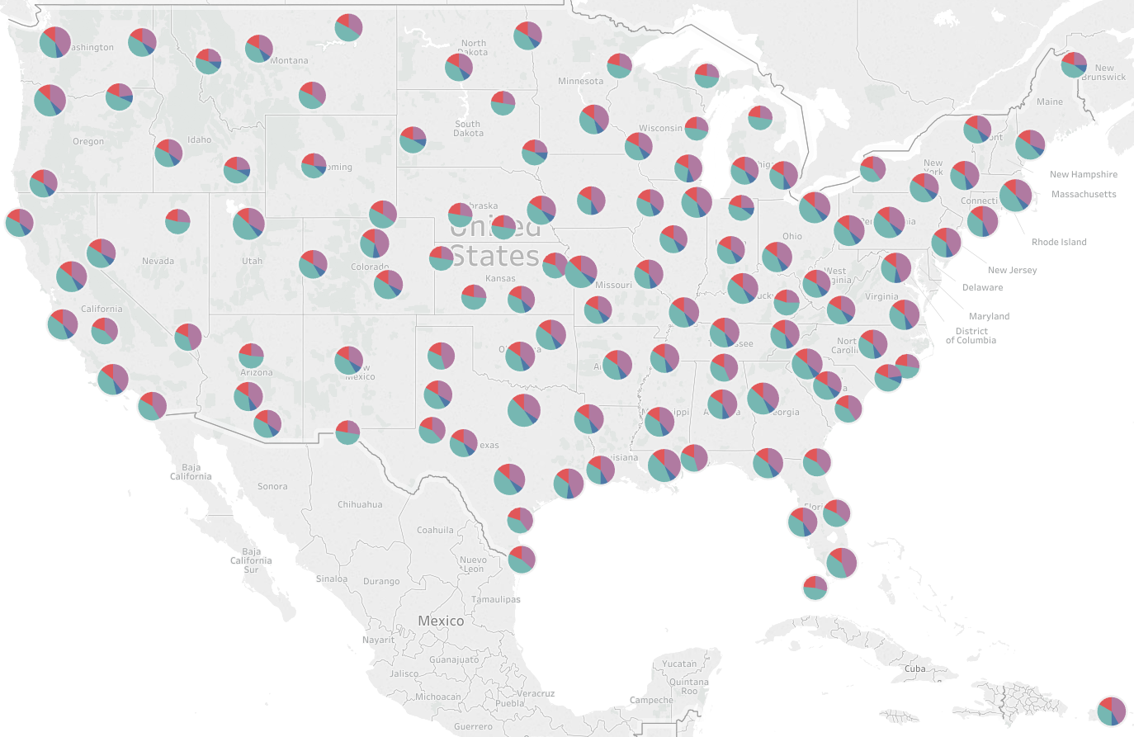
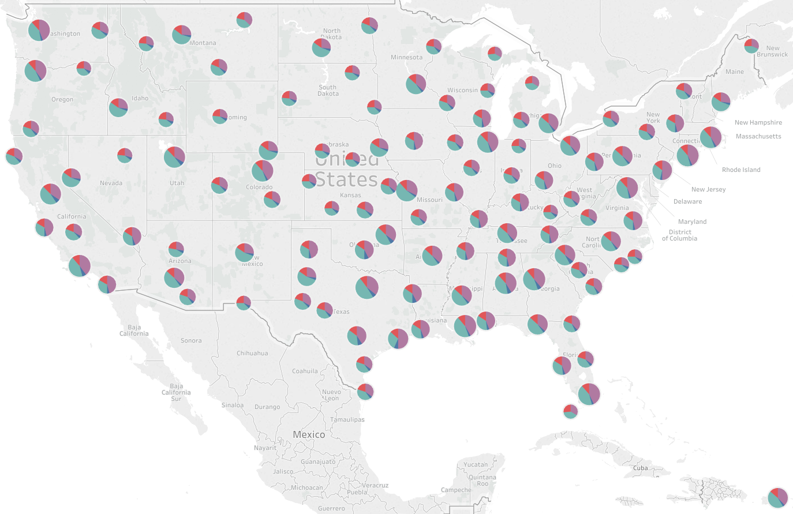
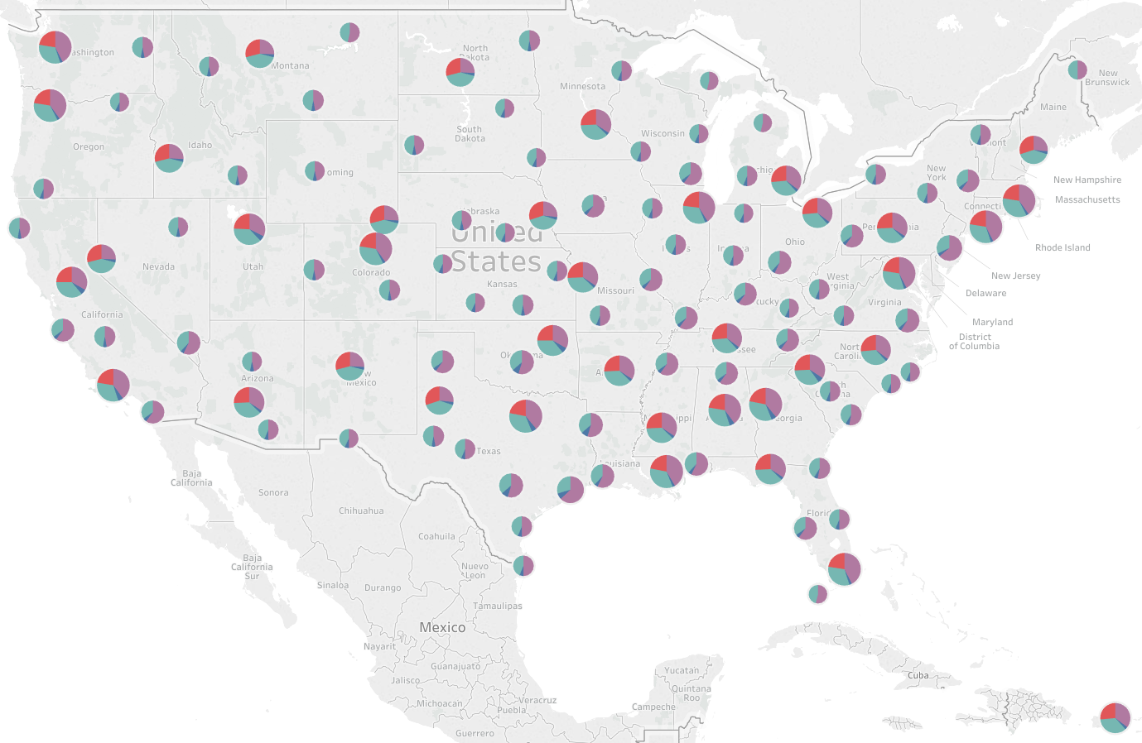
The phased approach allows for incremental redistribution of resources, subject to the outcomes of systematic testing and evaluation
Phase 3: Realizing the vision
Phase 2: Evolving form and function
Phase 1: Increasing flexibility
Potential staffing in each phase (CONUS only)
Key changes envisioned
Minimum 5 staff dedicated for IDSS duties
Smallest offices operating with a similar number of Meteorologists as some offices in Central today
~250 billets changed¹
Demand-based staffing in non-line met billets begins (observations, leadership, maintenance, science)
Some offices could begin reducing operating hours under clearly defined conditions (fair weather, etc)
~200 more billets change, ~450 total changes¹
Some offices no longer 24/7, supported by other offices with robust backup functions
~150 more billets change, ~600 total changes¹
1 ~1/3 of billets needing to change are vacant in this scenario
SOURCE: OWA Strategic Staffing workforce model

Slide 29
Evolve NWS vision of a potential future state, with strategic staffing to best meet partner needs and most efficiently use resources
Potential outcome of strategic staffing for all functions – Phase 3¹
Hypotheses to test prior to moving to final Phase
Not all forecast offices need to remain open in the evenings or overnight in order to meet the needs of the public and their partners – certain offices could be routinely closed overnight save in exceptional circumstances
Better service to partners can be provided when staff are not constrained to being in the WFO
<10-19
20-29
30+
IDSS2
24/7/365
Met watch
Hydro IDSS
Support³
1 There are offices of all sizes within these ranges, and offices could include embedded / “satellite” staff
2 Includes staff time spent on collaboration on the forecast, creation of specific forecast products (e.g., spot forecasts)
3 Includes staff for systems development & support, science & training, and leadership & administration

Slide 30
Phased testing and evaluation vision developed in fall 2016
DRAFT
FY17
FY18
FY19
FY20+
Overall
Improve service delivery to partners
Improve use of met time in the field
Work collaboratively across offices
Staff and operate according to partner needs
Details
Refine core services for deep and core partners, establish IDSS performance measures, and develop office IDSS plans
Develop detailed design for NBM grid policies
For the GS5-12 career progression, finalize competency model, develop training plan and HR tools, and begin detailed design for future WFO positions
Establish fully integrated field structure and strategic staffing “proof of concept”
Develop IDSS training, ongoing IDSS plan review process, and national IDSS support infrastructure
Establish national grid policies and shift production of some outlooks and advisory products to NCEP
Transition all GS5-11s to GS5-12 progression, update federal qualification standards for 1340s, re-vamp performance management, and streamline hiring process to manage attrition and upcoming workforce needs
Begin implementing and measuring “unlocks”, and develop WFO span-break role
Offer standardized IDSS products and services based on partner type
Establish the NBM as common starting point across field offices
Develop detailed design for duties, competencies, and positions for future roles
Change shift staffing levels and operating hours at some offices, using cohort approach, and develop dedicated 0-12hr met watch shifts
Use a collaborative forecast process across all service areas and time ranges to layer local and national expertise, based on a continuously updating 6D database
Shift positions to areas of greatest weather, water, climate IDSS need, and update roles and PDs as needed
Align office and staff location to partners where possible, re-draw CWA boundaries as needed, and staff cohort roles / regional span-breaks

Slide 31
NWS has identified several ways to meet demand by unlocking staff time and increasing flexibility within current office footprint and staffing levels
Seven functional and form “unlocks” can provide significant flexibility for NWS field offices
1
Strategic staffing
NWS will move away from “one-size-fits-all” staffing, allowing staff to be distributed to meet partners where they are
Addresses need to align staff to workload
2
Collaborative forecast process
Field offices use a common operating picture to ensure consistency and create a more efficient process that frees up valuable, needed staff time
3
GS5-12 career progression
Updated career progression for interns increases time spent by GS 5-11 meteorologists on high value activities contributing to IDSS
Address internal processes and role assignments that limit time needed for IDSS
4
Auto launchers
Automated launches free up staff at upper air sites and allow for flexibility in scheduling shifts
5
Shift scheduling flexibility
Office operating hours are set strategically to address partner needs, so not all offices devote resources to staying open 24/7. Requires offices to collaborate through mutual aid for met watch during off hours, while sustaining situational awareness and surge capacity
6
Staffing level flexibility
Offices set staffing levels to best serve partners, without requiring each shift to have two staff members
Address form constraints that limit flexibility needed – if unable to be unlocked, 40% of IDSS needs will remain unmet
7
Strategic positioning
Offices and roles are located to best serve partners and meet internal NWS needs (e.g., IDSS staff near partners, maintenance staff near strategic needs)
SOURCE: OWA Strategic staffing team

Slide 32
Diverse group of NWS staff contributed to ideas for adjusting operations to meet IDSS demand
1
Strategic staffing
“Grades and staffing levels don’t reflect the accretion of duties at all WFOs since [MAR], especially coastal offices that have marine and tropical responsibilities as well as the new IDSS component”
2
Collaborative forecast process
“The use of blended models and good tools could allow us to have one person handling grids and others doing IDSS”
“[When all elements] are modeled correctly, forecasters will accept the reduction in forecast grid editing.”
90% of MICs surveyed support the move away from grid production towards IDSS
3
GS5-12 career progression
90% of MICs surveyed reported that they would support a new GS 5-12 meteorologist development model
“Separate Intern and Forecaster rotations [limit IDSS] – combining would allow better shift and IDSS coverage”
4
Auto launchers
“We know our partners would rather have us working with them instead of being out launching weather balloons, when machines can do that”
5
Shift scheduling flexibility
“To really effectively allocate staff resources, I need to be able to count on having specific staff members/or focal points available in the day time, when core partners can meet”
“The health effects are well documented including low morale, depression, poor family life, and poor performance…We made this choice to work here, but that doesn't mean it can't be changed for the better”
6
Staffing flexibility
“I really don't need 2 people on the midnight shift or 3 on the evening shift. Those duties could be better accommodated during the day”
“Requirement of 2 staff on midnight shift [limits IDSS]”
7
Strategic positioning
“Our current office footprint isn’t based on our partners’ needs – it’s based on radar, and that means in many places we’re too far to serve our partners well”
SOURCE: NWS Insider feedback on OWA, OWA MIC survey April 2016, Interviews and working sessions with OWA team members

Slide 33
Current PMO structure blueprint and governance interface
EC
PIC MDC
Final governance and key decision authority, provide strategic guidance
Overall executive sponsor, routine decision authority
Executive champion from field leadership
OPPSD
Advisory Chair
Overall responsibility, tracking, escalating, and conduit for governance
Core field leaders with connection to project vision
PMO
Advisory Board
Content expertise and progressive vision
All-purpose problem-solver and liaison to the board
Objective Leads
Advisory staffer
Program leads
Labor-mgmt. relations, congressional affairs, communications, OOE team members, social science, ERM
Deep content knowledge from the lines of business
Internal support
Initiative leads

Slide 34
RDs outlined several tests for refining future state concept in fall 2016
Test concept
Working resource estimate
Considerations
1
Long-fuse watch collaboration
Up to 3 TDYs for 6 months (~$50K)
CR to provide space and IT
Could inform WPC FY17 milestone to develop watch plan
2
Produce grids for larger areas
TDYs if hosted at OPG ($5K / TDT month)
IT reconfigure for test sites
Could be done through field office group test
3
Single starting point for grids
0 - $60K per year depending on need for dedicated project manager for national expansion. Could share PM costs w/ 1,2,4
Builds on regional blends in use and CR test
4
Medium-range grid collaboration
$90K for participant OPG TVL & WPC TDY costs
MDC / PIC reviewing this test
5
Collaborative radar operations
Two six month TDYs (~$40K)
Verification software / IT support
Could be done through field office group test
6
Met watch mutual aid concept of ops
Travel for a facilitator
Overtime cost of shadow shifts
IT reconfigure for test sites
Could be done through field office group test
7
1 per shift staffing
…
Could be done through field office group test
8
Virtual office ops
~$450k in travel, lease space
Could be difficult to wind down given increased partner support
SOURCE: OWA strategic staffing team

Slide 35
RDs outlined several tests for refining future state concept in fall 2016 (continued)
Test concept
Working resource estimate
Considerations
9
Field office group ops
~30k in travel funds, facilitator TDY
IT reconfigure for test sites
Enables many other tests
Builds field buy-in
10
Cohort science manager
40K per year
Strategic span break that could improve R2O / O2R and SOO mentoring
11
Cohort IDSS manager
40K per year
Strategic span break that could ensure consistency of IDSS across core / deep core partners
12
Cohort leader
40K per year
Could address RD span break providing improved consistency, accountability, and management, across all WFO programs and services
SOURCE: OWA strategic staffing team

Slide 36
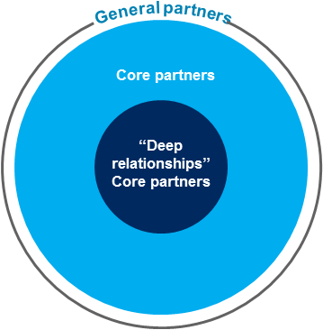
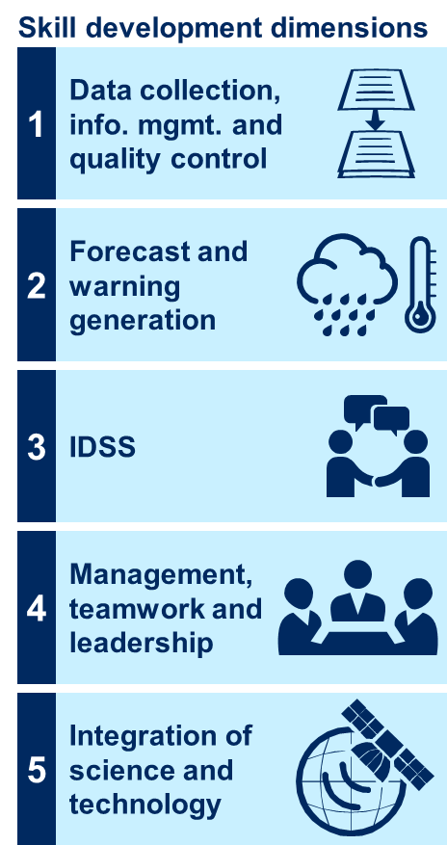
Review of key OWA decisions
Operating model
NWS will pursue the IDSS deep relationships model and a collaborative forecast process
While NWS will improve services to all of our partners, it will focus IDSS efforts on deep relationships core partners
The collaborative forecast process will be built on a common operating database, and will layer expertise from national to local levels
Workforce
NWS will enhance the skill level of GS5-12 meteorologists across science, service, and leadership dimensions
NWS will pursue a competency-based GS5-12 career progression

Slide 37
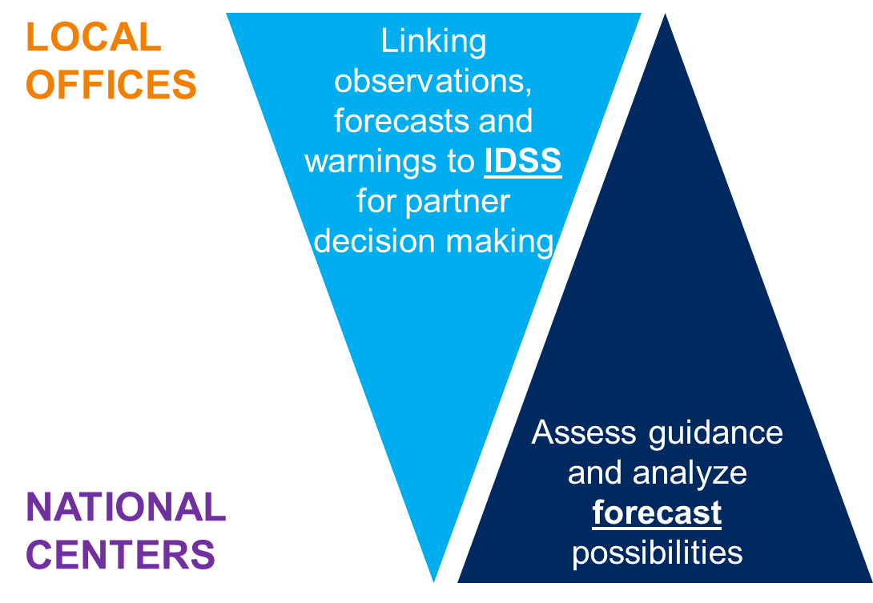
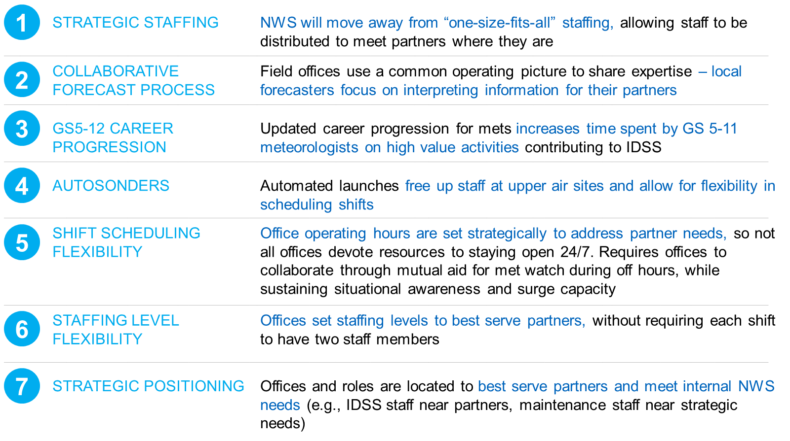
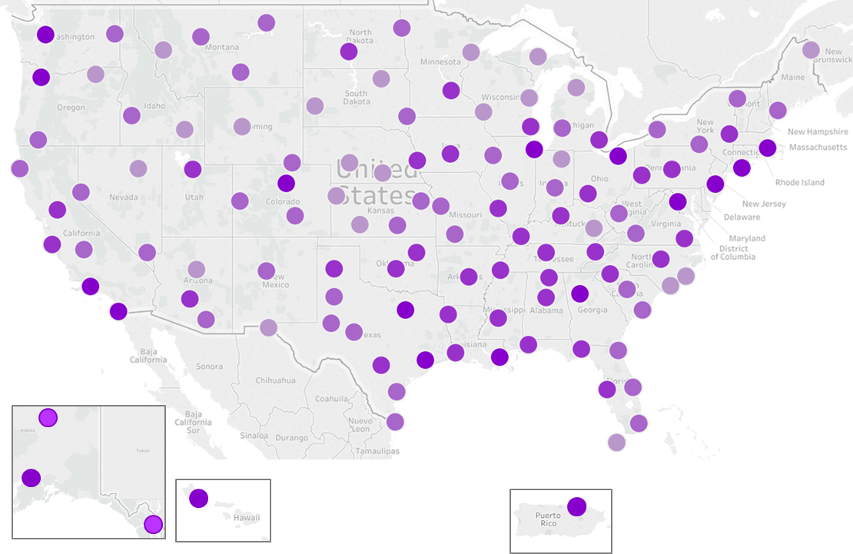
Review of key OWA decisions (continued)
Organizational structure and strategic staffing
NWS will align IDSS and forecasting functions to expertise, across national, regional, and local levels
National, regional, and local offices will each play a role in forecasting, warnings, and IDSS, but the balance of time will be different
NWS will pursue ways for offices to group together to share resources and collaborate on forecasts, warnings, and IDSS (i.e., through field office groups)
NWS will increase flexibility of staff in the field to enable more time spent providing IDSS
NWS will pursue “seven unlocks” to free up staff time
As NWS frees up staff time, it will shift positions (and consider staff moves) to areas of greater IDSS need
Field Directors have developed an initial perspective on how many staff would be needed in each office, which will be refined through testing and evaluation

